Slide 1
TEAM WORK
BY Trivedi Riddhi.

Slide 2
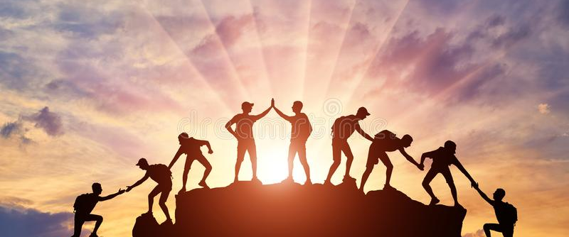
Team Work

Slide 3

What Is Team Work ?
A team is small number of pepole with Complementary skills who are committed to a common purpose,performance goals,and approach accountable
Small Number
Complementary Skills
Common Purpose & Perfomance Goals
Common Approch
Mutual Accountability

Slide 4
Why Use Teams ?
Most Of today's business assignments are addressed by multidisciplinary teams.
Team building is an important part of the modern workforce.
Team building is an important part of your preparation for enginnering practice

Slide 5
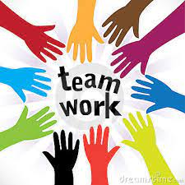

Slide 6
Advantages and Challenges
Advantage: When the group works together,the accomplishments will surpass any results associated with any one individual.
Challenge: Any team member functioning independently of other team members or competing with them will REDUCE the performance of the team - EVERYONE's outcome.

Slide 7
Advantages and Challenges
Advantage: Every person can contribute in some way.
Challenge: No member's contributions should even be automatically disregarded.

Slide 8
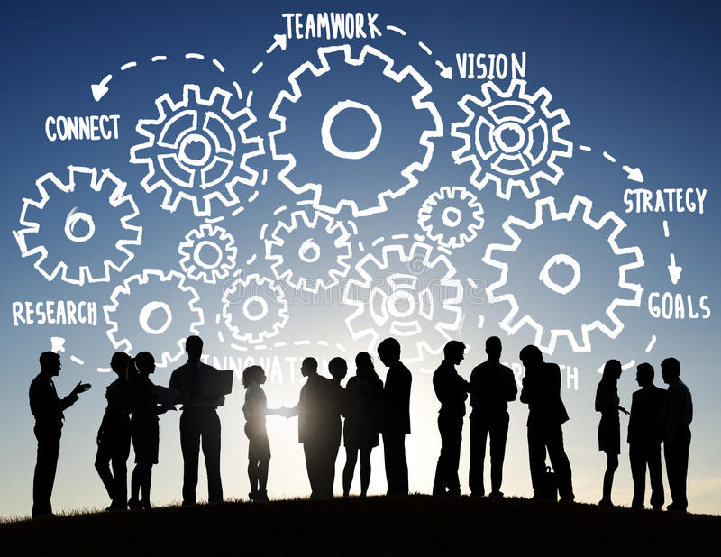

Slide 9
REMEMBER
Together
Everyone
Accomplishes
More
With
Organization
Responsibility
Knowledge

Slide 10
Positive Roles in a Team Setting
Defining issues
Proposing tasks
Seeking information and opinions
Clarifying
Summarizing
Compromising; Consensus building

Slide 11
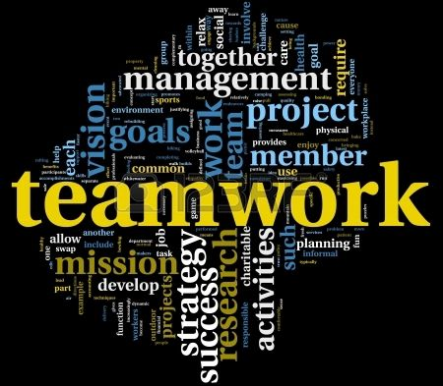

Slide 12
Negative Roles In a Team Setting
Dominating: asserting superiority
Withdrawing: not talking; sulking
Avoiding:skipping meetings
Degrading:putting down other's ideas
Being uncooperative: side conversations

Slide 13
How to be a good team member ?
Be a good listener
Be honest and open
Accept other people's needs
Don't be negative
Don't be defensive
Learn to take the initiative

Slide 14
How to be a good team member ?
Become more sensitive to the different ways
people communication
Take a risk
See the uniqueness in each team member
Be trusting-of yourself and responsible

Slide 15
Thank You

